Slide 1

Showwcase User Engagement Metrics
Prepared By Rugved Gole

Slide 2
How is User Engagement Defined?
Activity Score of Customers (Posts, Likes, Comments)
Net Active Duration (Active Duration – Inactive Duration)
Customer Visit Frequency
Customer Count on a day of month
Activity Score on a day
Net Active Duration on a day
Bugs encountered by customers in a day
Projects added on a day

Slide 3
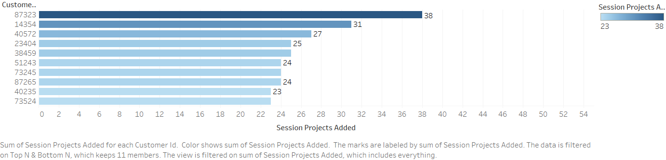
Customer ID v/s projects added over the month
Top Customers who added the maximum number of projects in the month of October

Slide 4
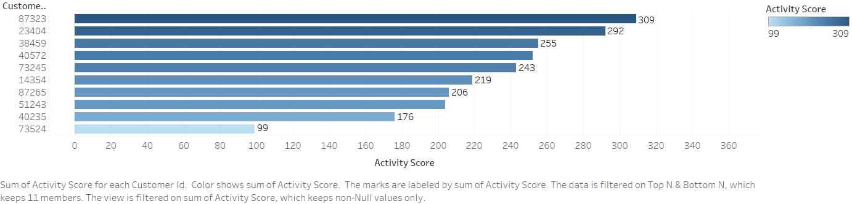
Customer ID v/s Activity Score
Activity Score = Session Projects added + Session Likes given + Session Comments given
Top Customers who were Actively using the website in the month of October

Slide 5
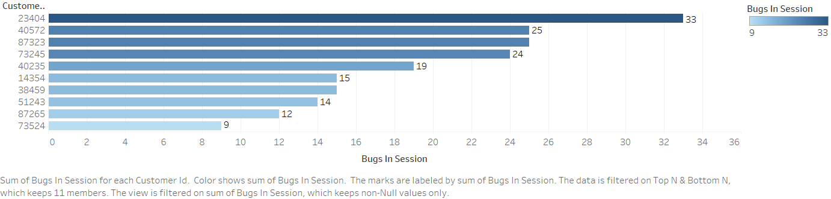
Customer ID v/s Number of Bugs in Session
Top Customers who encountered most amount of bugs in the month of October

Slide 6
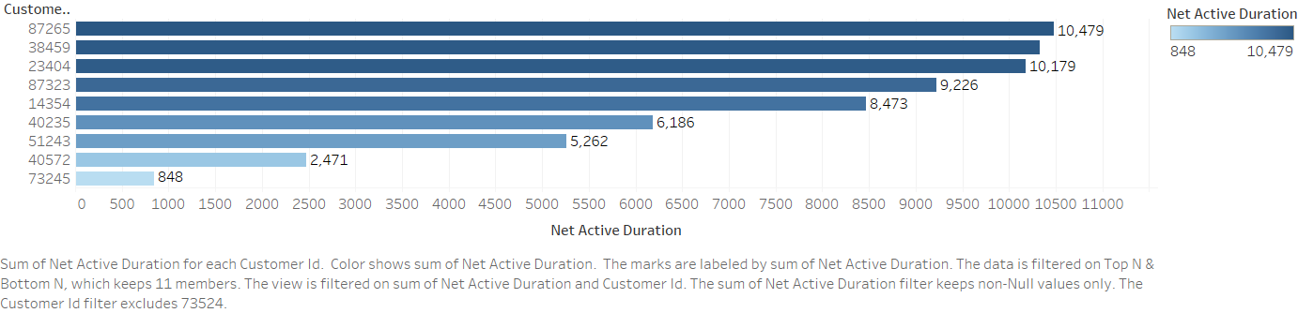
Customer ID v/s Net Active Duration
Net Active Duration = Active Duration – Inactive Duration
Top Customers who were most duration active in the month of October

Slide 7
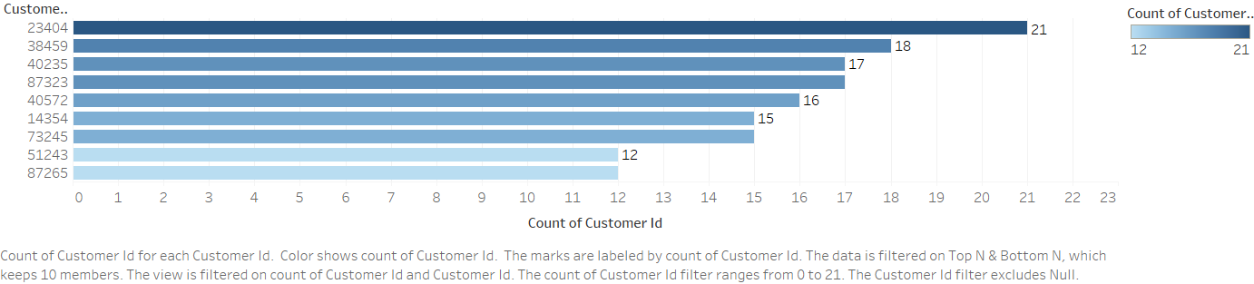
Customer ID v/s Frequency of Visits
Customers who visited the most in the month of October
Customers who can be said as regularly visiting customers in the month of October

Slide 8
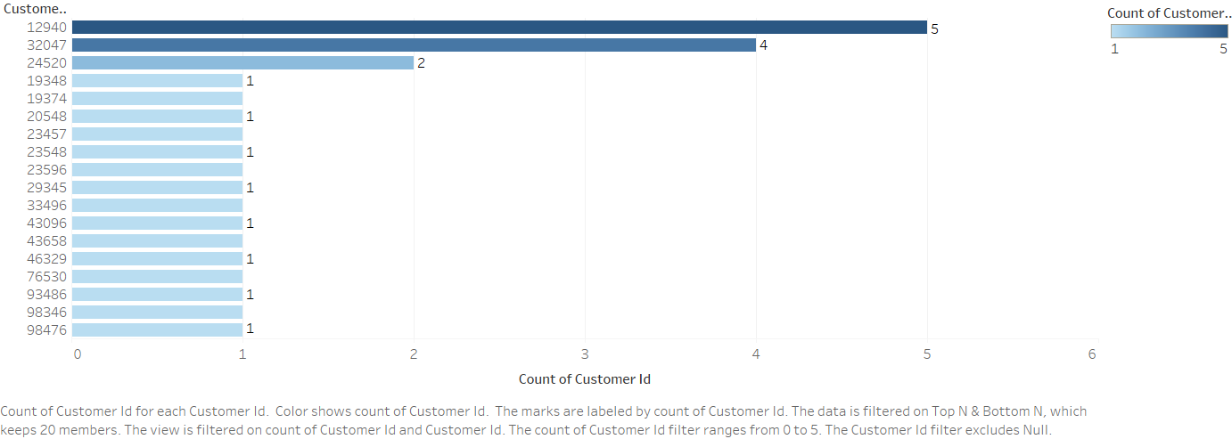
Customer ID v/s Frequency of Visits
Customers who visited the least in the month of October
Customers who can be used to target with advertisements and promotions to attract them to out portal

Slide 9
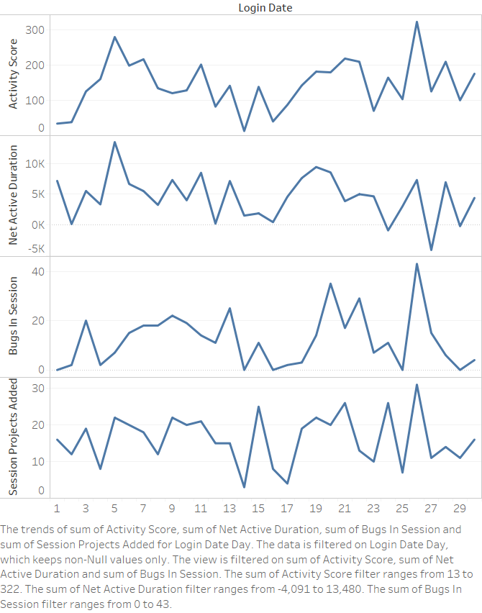
Login Date Analysis
Login Date v/s (Session Projects Added, Bugs in Session, Net Active Duration, Activity Score)

Slide 10
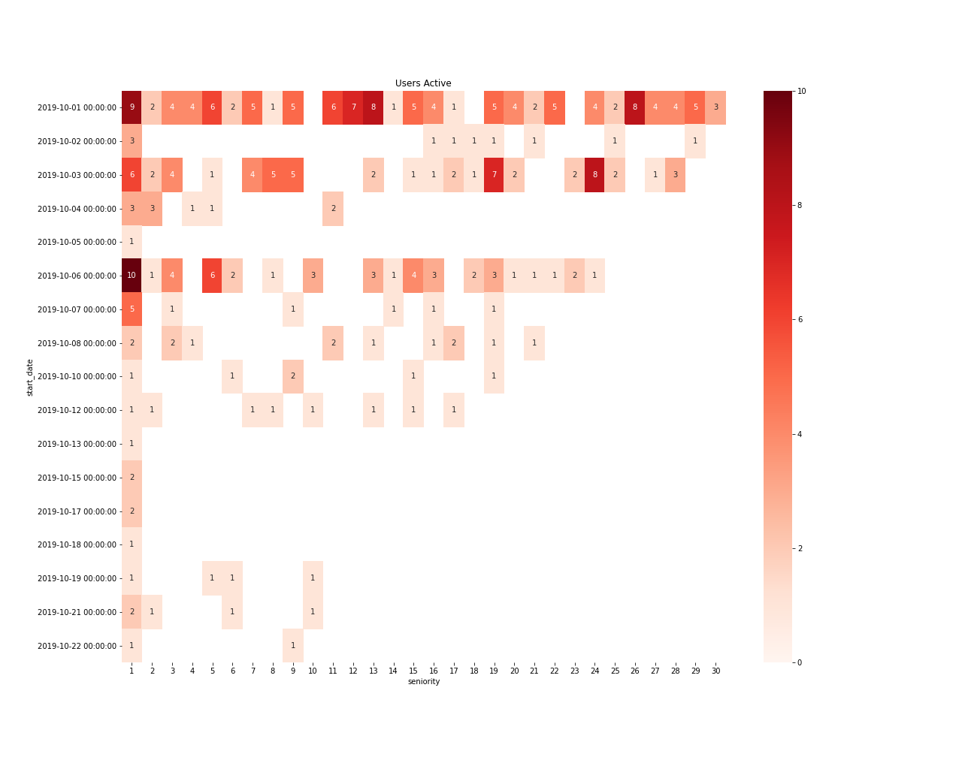
Heat Map for Retention Counts

Slide 11
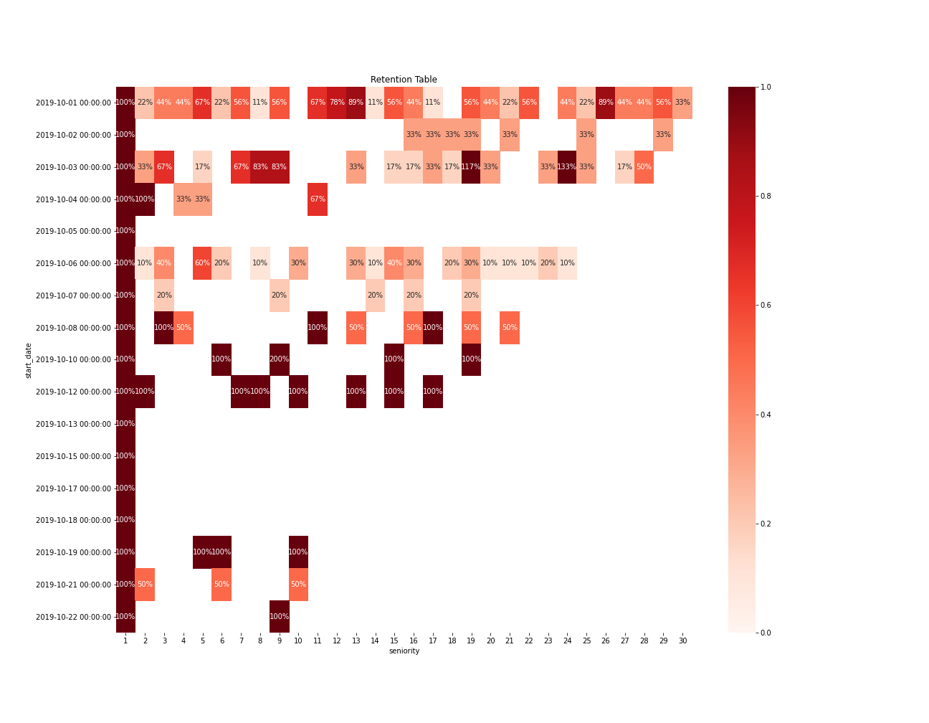
Heat Map for Retention Rate

Slide 12
Insights
There are around 19 customers who have visited the website just twice. These customers can be approached with incentives and promotions
Customers who encountered bugs are not prone to leave the website, but it is something that needs to be taken care by the technical team
Saturdays can be found most active. 26th October 2019 is found out to be the busiest day with most activity on the website, followed by 5th October 2019. Both are Saturdays
Customers who logged in on 1st October 2019 had the highest retention rate, followed by mid of October, which can be because of a promotion campaign
Customers who visited the website was least on week days

Slide 13
Thank You

